Slide 1
Introduction to ESPHome

Slide 2
Agenda
Overview of ESPHome
Advantage of using ESPHome
Getting started With ESPHome
Useful resources

Slide 3

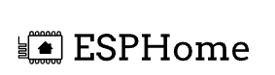

Overview of ESPHome
There are several options available for Microcontroller like ESP32, and ESP8266 to create your firmware and flash your device with your application.
Arduino IDE
ESPHome
PlatformIO
To decide which platform you require you need to consider your application like what purpose you want to solve
Source.-https://platformio.org/, https://esphome.io/#, https://www.arduino.cc/en/software

Slide 4
Advantage of using ESPHome
Purpose: ESPHome is designed to simplify the process and allow users to integrate them easily into the Home Assistant home automation platform.
Integration with Home Assistant: One of the primary features of ESPHome is its seamless integration with Home Assistant, an open-source home automation platform.
Configuration Using YAML: ESPHome uses YAML (Yet Another Markup Language) for configuration, making it accessible to users without extensive programming experience.
Over-the-Air (OTA) Updates: ESPHome supports Over-the-Air updates, allowing users to update the firmware on their devices remotely without the need for physical access to the devices.
Flexibility: ESPHome can be used not only with a Home Assistant but also independently. Users can deploy ESPHome firmware on devices for various IoT applications beyond home automation.
Application: It can also connect with Text sensors like MQTT subscriber, Modbus, and Many more

Slide 5
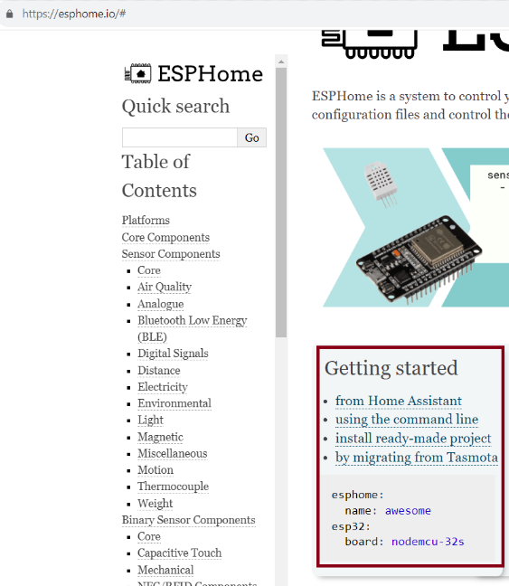
Getting started With ESPHome
You can use the ESPHome feature in several ways
Using a Command line From the Home assistant
Ready-Made Projects
Source: https://esphome.io/#

Slide 6
Useful resources
There are several resources available and I am listing down the resources which I have used.
Install the ESPHome as an addon in the home assistant
Source: https://esphome.io/guides/getting_started_hassio.html
Install the ESPHome as a Commandline
Source: https://esphome.io/guides/getting_started_command_line
Video I used for a method of installation of ESPHome
Source: https://www.youtube.com/watch?v=mCs0fa7Gr9U
For Home assistant
Source: https://www.home-assistant.io/installation/windows
https://www.youtube.com/watch?v=czhWTAH7YEA

